Slide 1
Sales Prediction

Slide 2
Purpose
The purpose of this analysis is to assist retailers in understanding the properties of products and outlets that result increased sales.
A rich dataset is used which contains a variety of variables, including sales.

Slide 3
Description of Data
The key variables which are explored to understand their effect on sales:
product fat content,
the visibility of the product (% of total display area of all products),
the product category,
maximum retail price,
the year when the store was established,
store size,
type of area where store is located,
type of outlet.

Slide 4
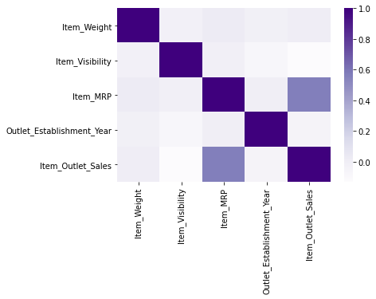
Correlation with Sales
Notes:
cfc

Slide 5
Correlation with Sales
The heatmap on the previous slide demonstrates a moderate correlation between sales and maximum retail price. This is to be expected.

Slide 6
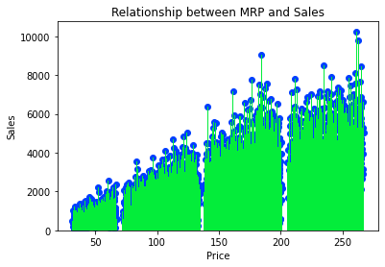
Sales and Item MRP

Slide 7
Model to predict sales
To predict sales, we have several choices of models. The models use the variables, previously discussed, to determine the impact on sales.
The models explored in this analysis include:
Linear Regression Model
Decision Tree Model
Bagged Tree Model
Random Forest Model

Slide 8
Model to Predict Sales
Each model has its own advantages, but the best model has the better predictive strength, as measured by a metric called R-Sq, and lower error in prediction as measured by a metric called Root Mean Squared Error.
After running all the models, the model with the best predictive ability is the Linear Regression model. The Linear Regression model uses a linear relationship between sales and the various variables that predict sales. Our model has moderate ability to predict outlet sales.

Slide 9
Thoughts for Future Work
As the model only has moderate ability to predict sales, it lays groundwork for future, improved studies.
During the course of the data analysis, some data was lost because of missing values. Two categories of lost data include:
The size of the outlet
The weight of the item being sold
It may be valuable to have this data in a future study and include it in the model.

Slide 10
Thoughts for Future Work
More data categories can be obtained by conferring with subject matter experts and gathering additional data to produce a model with better predictive ability.

